Slide 1
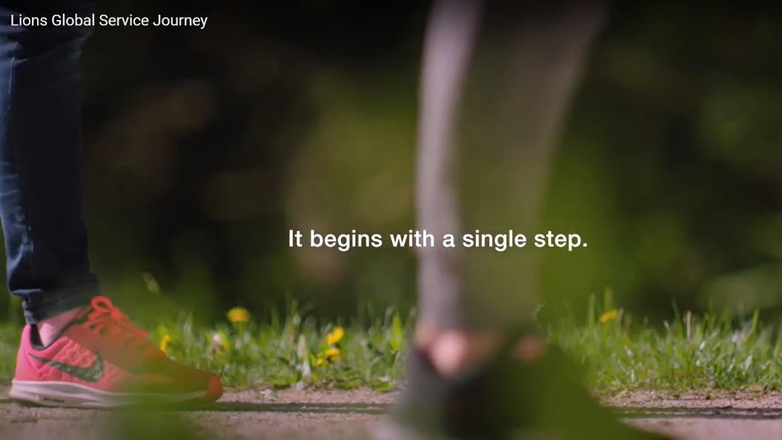

Slide 2

Who are we?
Lions Clubs International
Notes:
Trainer Tip: Enter additional information as you see fit, such as the name of the New Member Orientation trainer. Use this PowerPoint along with the New Member Orientation Training Guide. Be sure each of your participants has a New Member Orientation Guide to follow along with the presentation.

Slide 3
Lions
We Serve
We Make A Difference
Everyday, Everywhere !

Slide 4
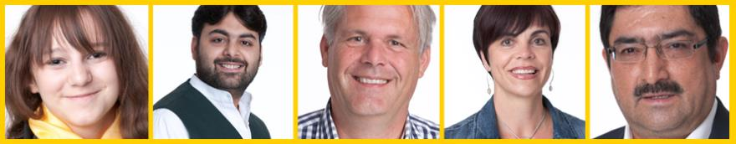
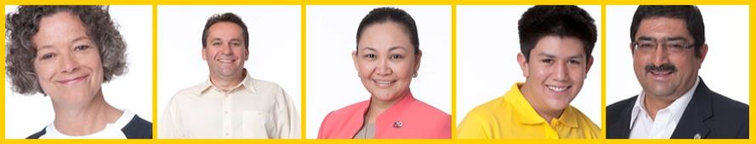
Who Lions Are
We are men and women of all ages, races and gender dedicated to serving those in need, whether in our own community or around the world.
  Over 1.4 million members
  Over 200 countries
  More than 48,000 clubs

Slide 5
Who Lions Are
Vision Statement: To be the global leader in community and humanitarian service.
Mission Statement: To empower volunteers to serve their communities, meet humanitarian needs, encourage peace and promote international understanding through Lions clubs.
Motto: “We Serve”

Slide 6
We have been around for over 100 years ….
We are now in our 2nd century of service
Did you know that Lions have a seat in the UN Assembly?

Slide 7

1917: Melvin Jones founded LCI.
1920: LCI becomes international with Canadian club.
1925: Helen Keller challenged Lions to become “knights of the blind.”
1945: LCI helped draft the United Nations Charter.
1957: The Leo Club Program is created.
1968: The Lions Clubs International Foundation is established.
1990: SightFirst is launched.
Today: Our international network has grown to include more than 200 countries and geographic areas.
1987: LCI became the first service club organization to admit women as members.

Slide 8
We are an International Association
International officers implement policy and serve as inspirational leaders of the world’s Lions.
  International President: Brian E. Sheehan
  Immediate Past President/LCIF Chairperson: Douglas X. Alexander
  First Vice President: Dr. Patti Hill
  Second Vice President: Fabrício Oliveira
  Third Vice President: A P Singh
The International Board of Directors is the governing body of the association.
  34 members
The International Constitution and By-Laws govern the operations of the association and establish the rules by which the association is to function.

Slide 9
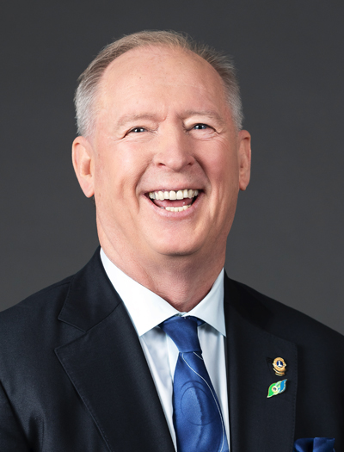
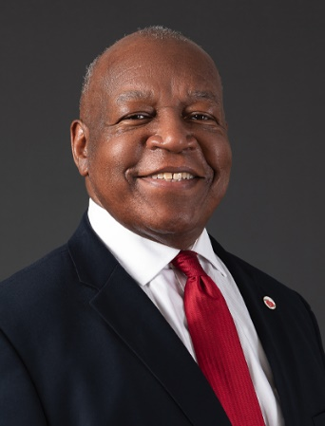
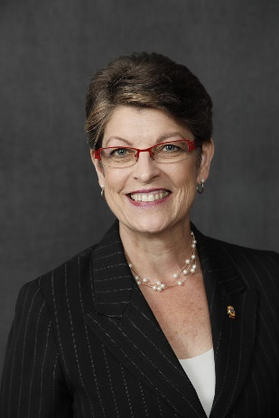
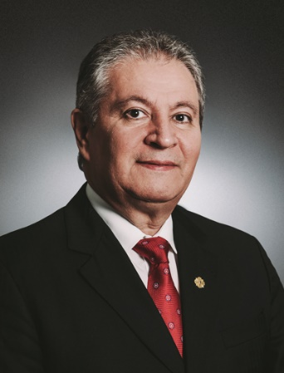
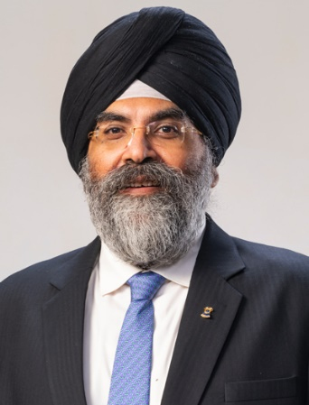

Slide 10

Brian Sheehan
International President 2022/2023

Slide 11
50+ Years of Impact
  US$120 million in disaster relief funding
  16 million children served by Lions Quest
  9.1 million cataract surgeries
  Millions of children vaccinated against measles

Slide 12

Service Activities
Because Lions seek to address the greatest needs in their communities, our activities are varied, although Lions are united behind five global causes. The Global Service Team (GST) is the driving force behind these programs and collects and shares service stories that empower leaders to act.

Slide 13
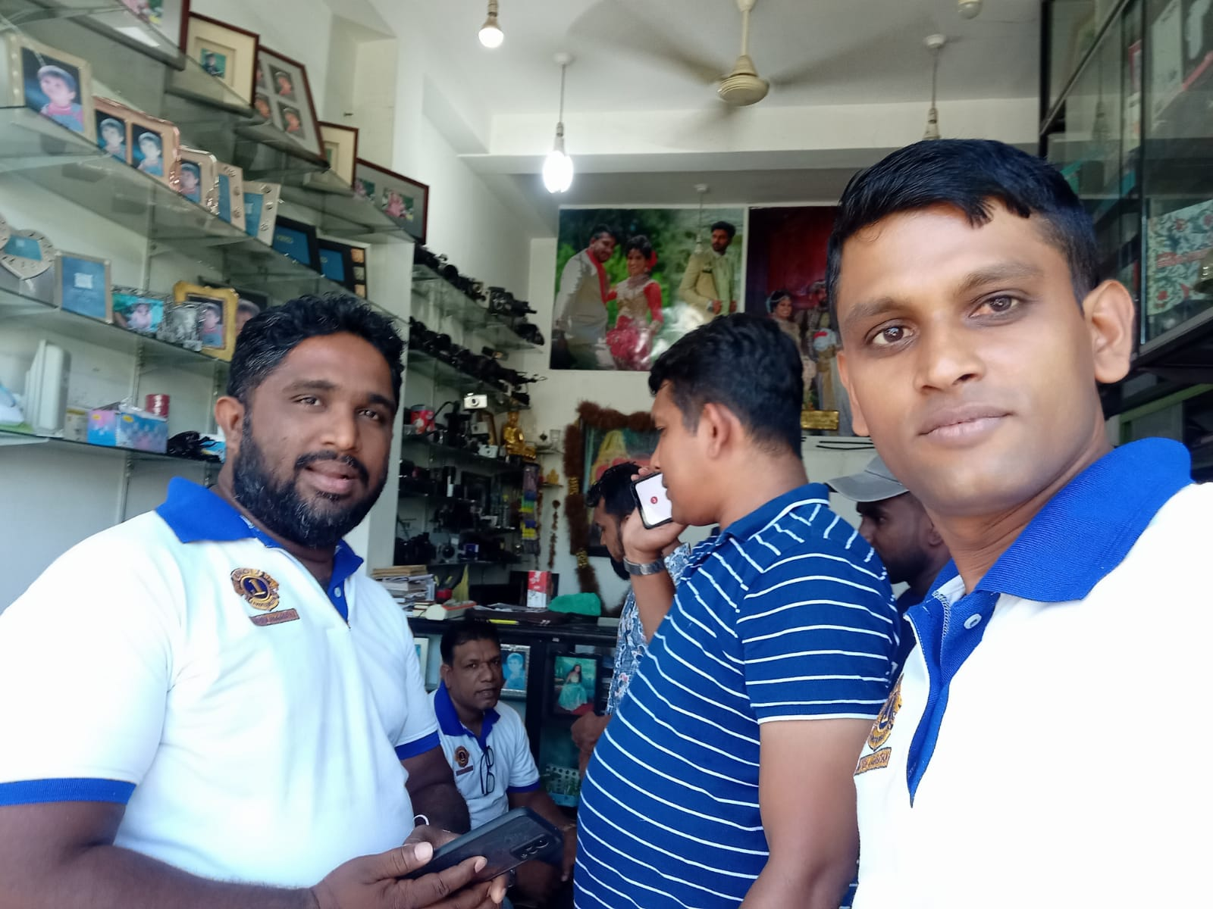
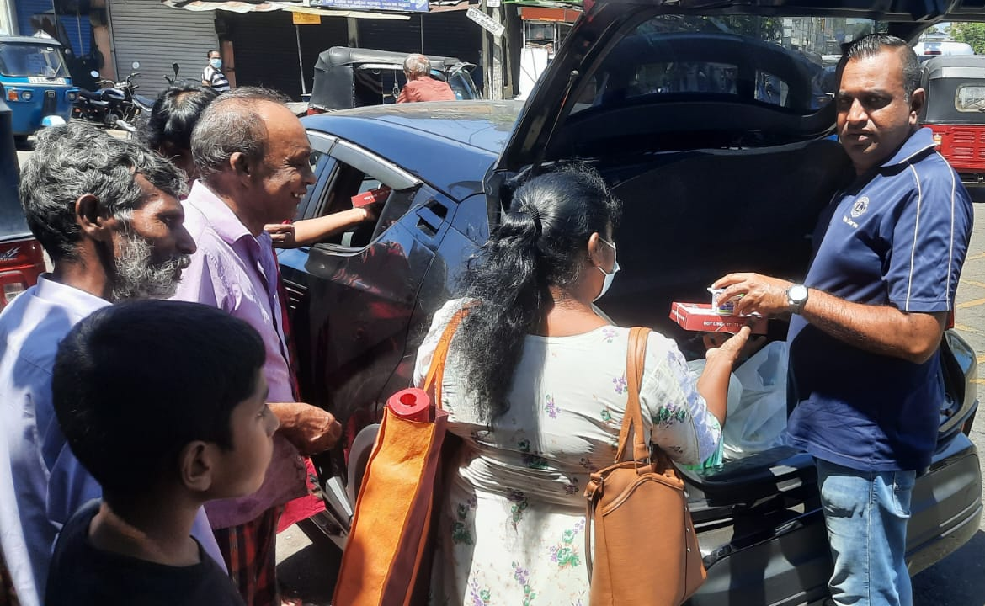
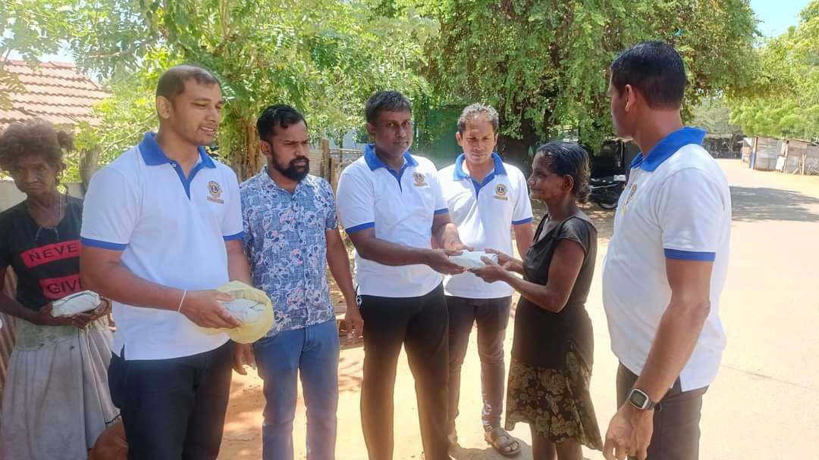
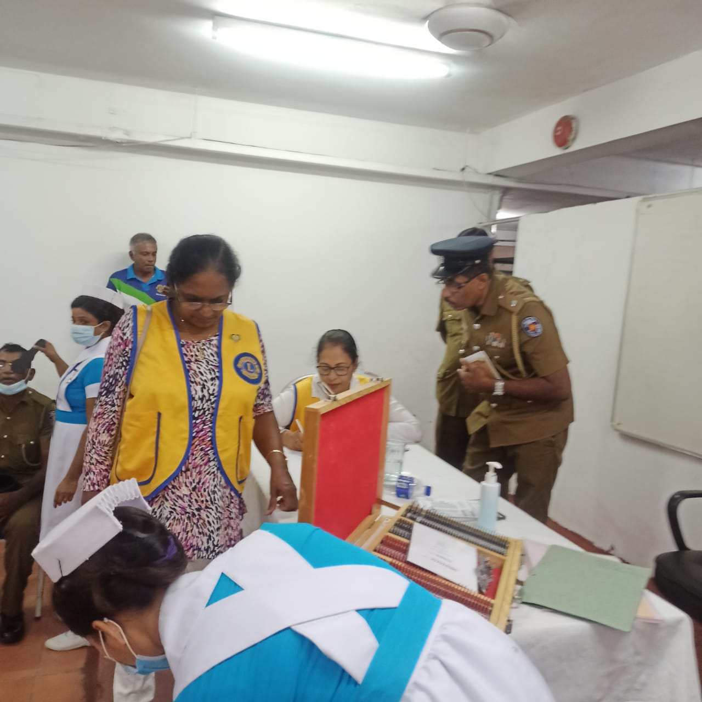
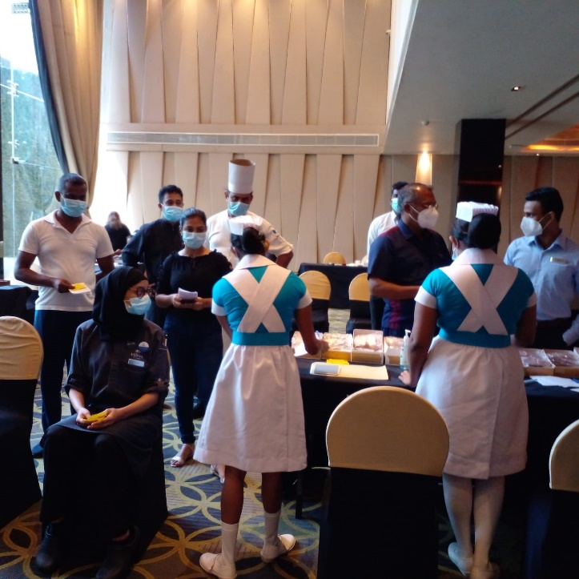
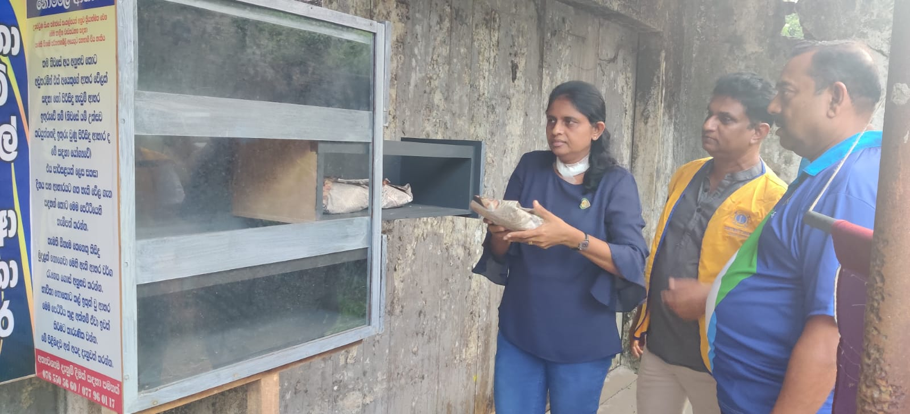
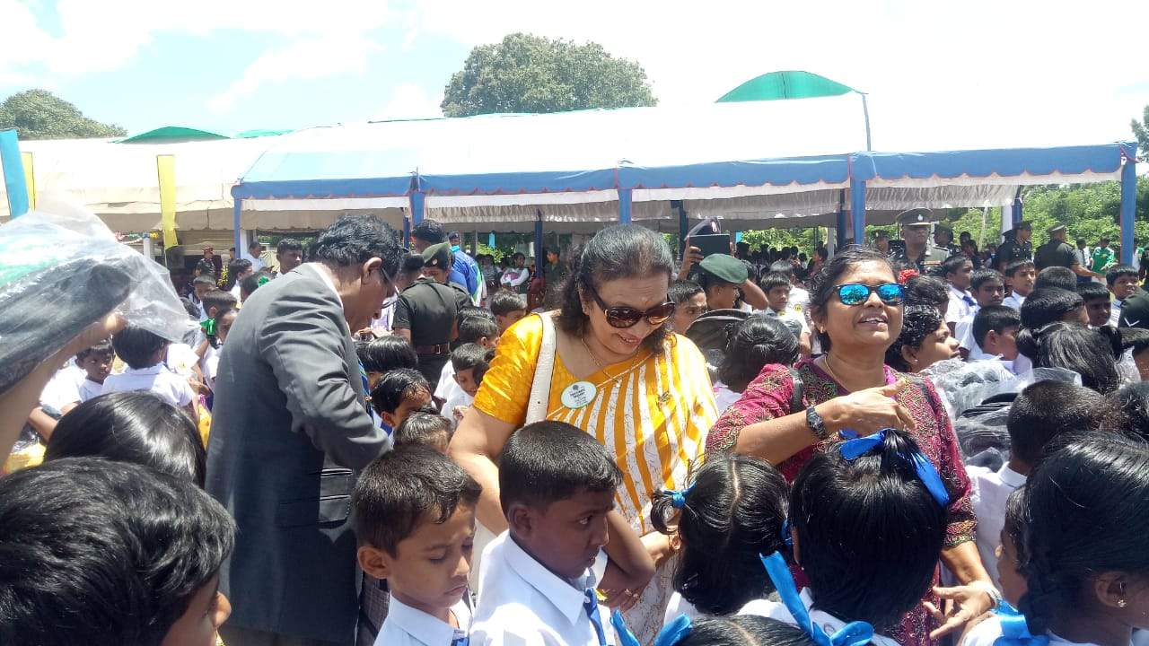
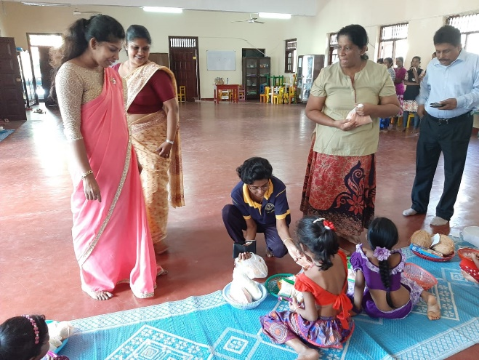
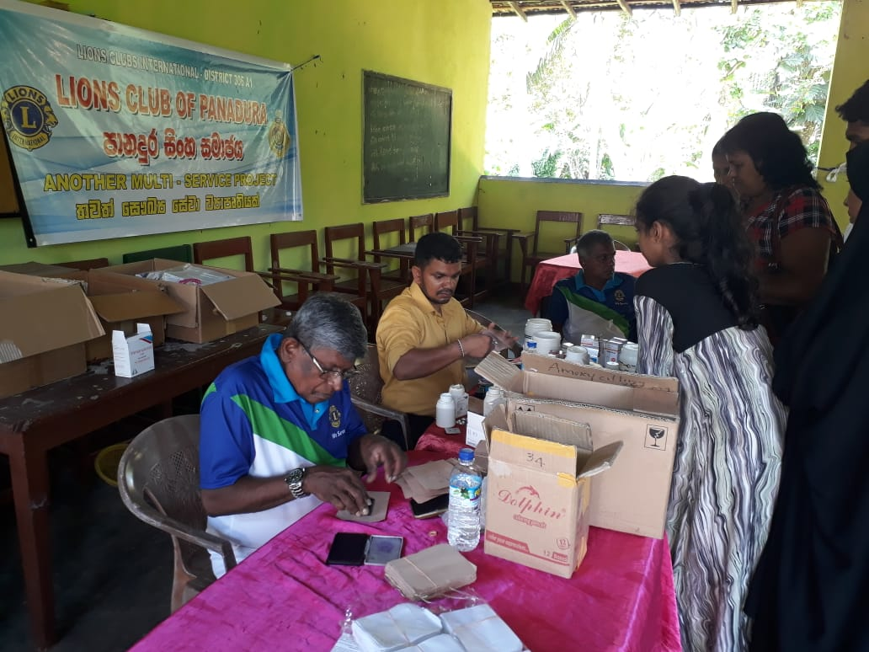
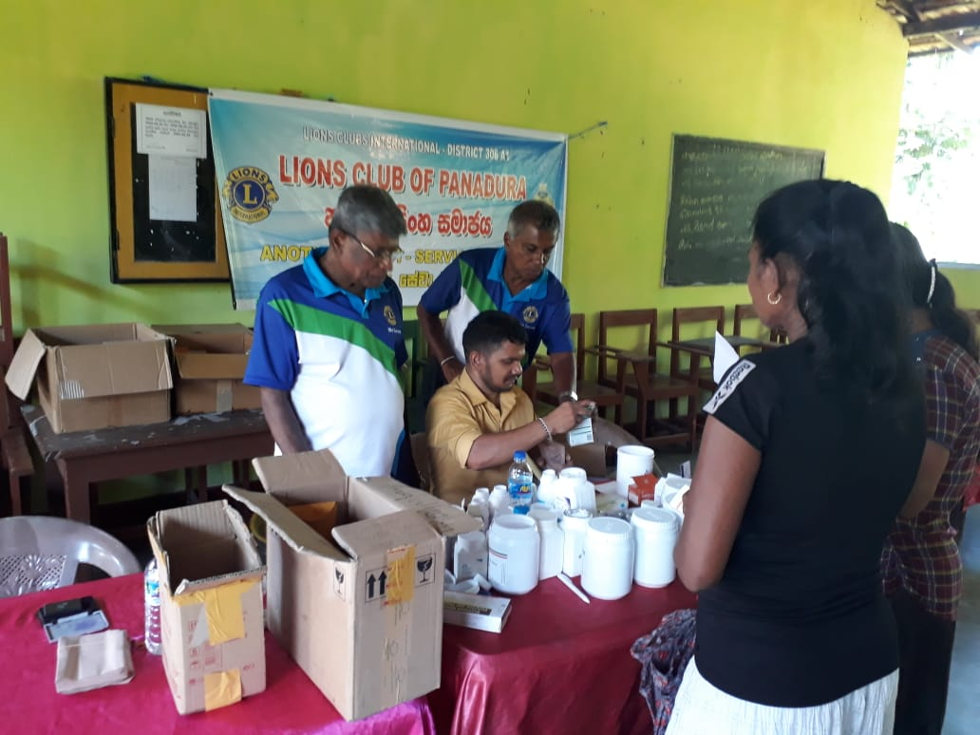

Slide 14

Leadership
LCI provides training and development opportunities for Lions. The Global Leadership Team (GLT) is the driving force behind these programs, including:
  Emerging Lions Leadership Institutes
  Advanced Lions Leadership Institutes
  Faculty Development Institutes
  Regional Lions Leadership Institutes
  District Governors-Elect Seminar
  Multiple District Leadership Development Funding
  GLT District Funding Support Program
  Webinars
  Lions Learning Center
  Lions Certified Instructor Program

Slide 15
DIVERSITY IS WELCOMED & CELEBRATED
The benefits of Lions clubs membership are numerous, and include:
Be part of a global community for good and the world’s largest service organization
Support, tools and resources to enhance your service
The satisfaction and joy of helping those in need
Leadership development opportunities
Networking opportunities with local and international
community leaders
Friendship and fellowship with service minded people
Respect and credibility of being a Lion
Membership in a Lions Club is open to anyone who is invited by a Lion.

Slide 16

VOLUNTEER WITH US. CHANGE LIVES.

Slide 17
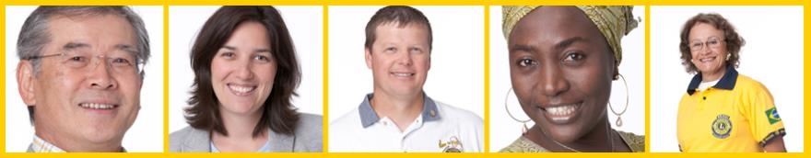
Lions Multiple Districts & Districts

Slide 18
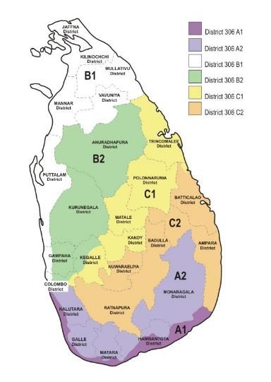
Organizational Structure
There about 750 districts with 35 or more clubs and at least 1,250 members in each district.
  Each district has a district governor
Multiple districts are formed by two or more
districts within a territory.
Our Multiple District: 306, Sri Lanka
Our District: 306A1
Notes:
Trainer Tip: Consider adding additional information about your district and multiple district, such as boundaries of your district and multiple district.

Slide 19
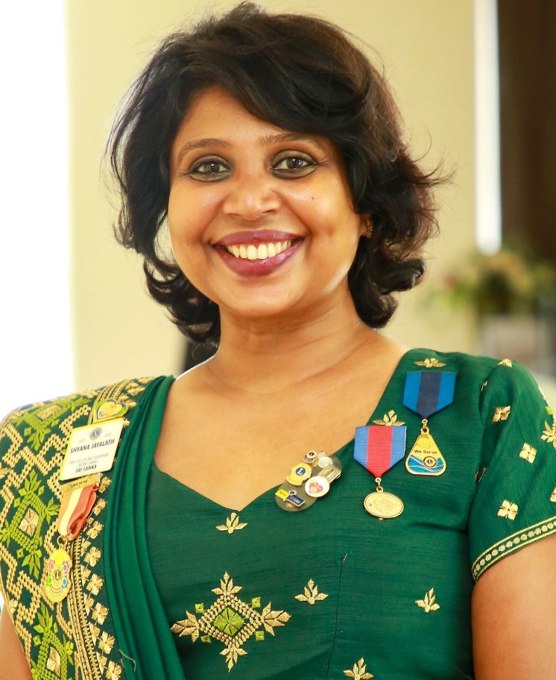
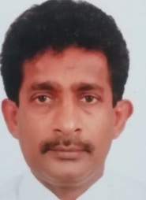
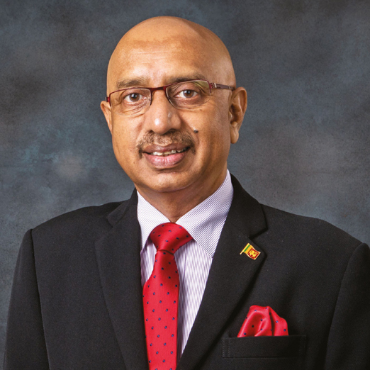
District 306A1 Leadership 2022/2023
  District Governor
  Lion Shyana Jayalath
  First Vice District Governor
  Lion Keerthi Gunawardane
  Second Vice District Governor
  Lion Dr. Priyanga Pupulawatte
Notes:
Trainer Tip: Briefly go over the roles of each of these positions. The roles are found in the trainer and participant’s guide.

Slide 20

District Governor’s program 2022/2023
BELIEVE IN THE POWER OF ONE – TOGETHER WE CAN

Slide 21
Program for the year.
Build our capacity to serve by introducing 500 new members.
Expand our service to impact 1,000,000 people.
Strengthen our Lions Clubs through effective administration.
Support our Global Foundation, LCIF.
Enhance our brand image as an international service organization through effective communication with our communities, the general public, and with one another.

Slide 22
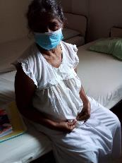
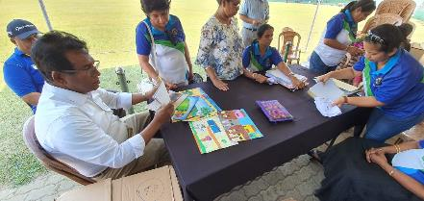
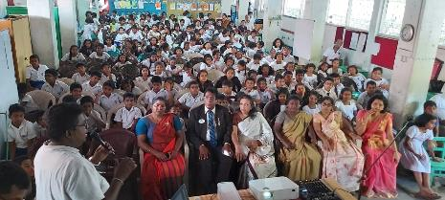
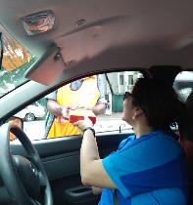
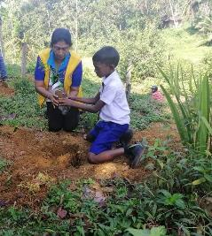
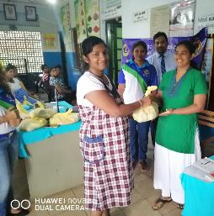
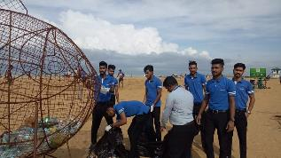
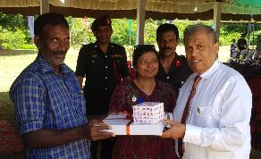
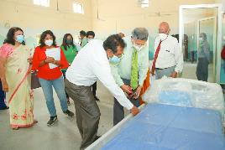
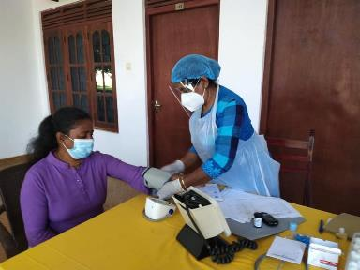
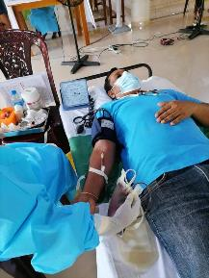

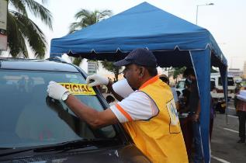

Slide 23

We welcome you to be a part of a new service journey

Slide 24
Dues and Budgets
Dues payable as a Lions Club member
  Dues payable at time of joining/ Entrance Fees
    International Joining Fee : US$ 35 (Not applicable until December 2022)
    Annual International Dues : US$ 43 (We have a special facility this year)
    Special for this year for any new member joining before December 31, 2022
    Annual fee of approx. Rs. 12,000
  Estimated annual payment thereafter
    The annual fees of a club that covers International dues, District dues and Club Admin Fees ranges from Rs. 20,000 upwards. There can be changes to the rates due to the foreign exchange fluctuation.
Notes:
Trainer Tip: Explain that the activities budget consists of funds raised form the public through club projects and may only be expended to satisfy a community or public need. The administrative budget is what finances club operations and comes mostly from club dues.

Slide 25
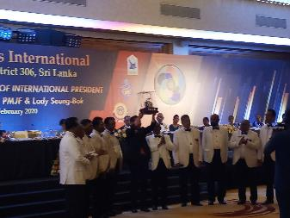
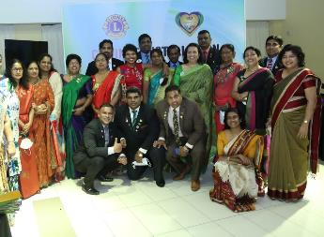
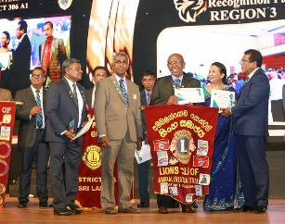
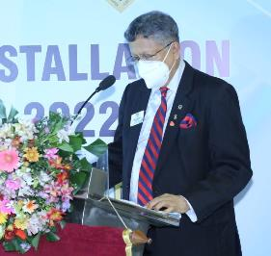
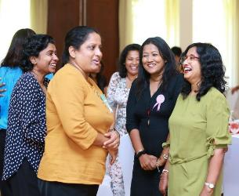
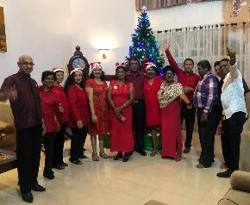
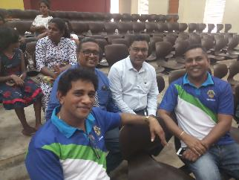
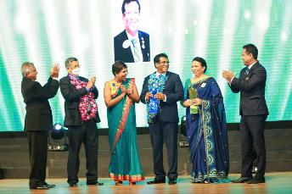

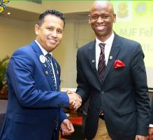
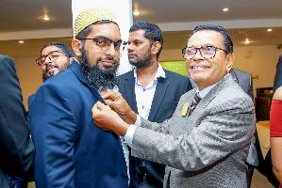
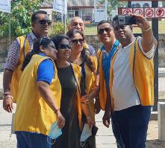
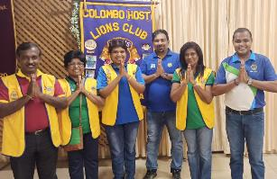

Slide 26
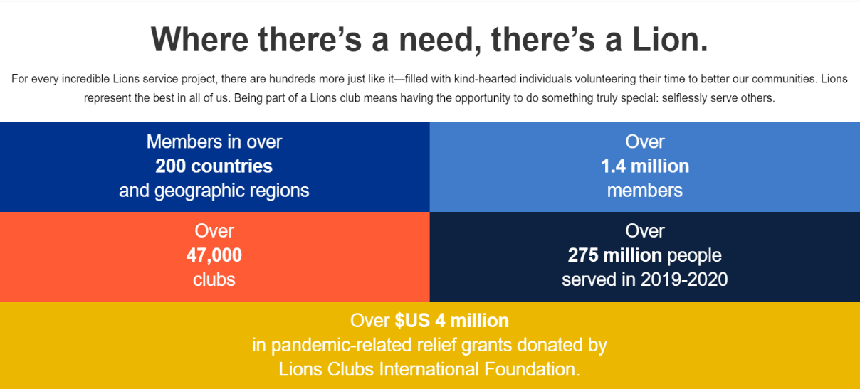

Slide 28
Volunteer with us.
Change Lives!

